Slide 1
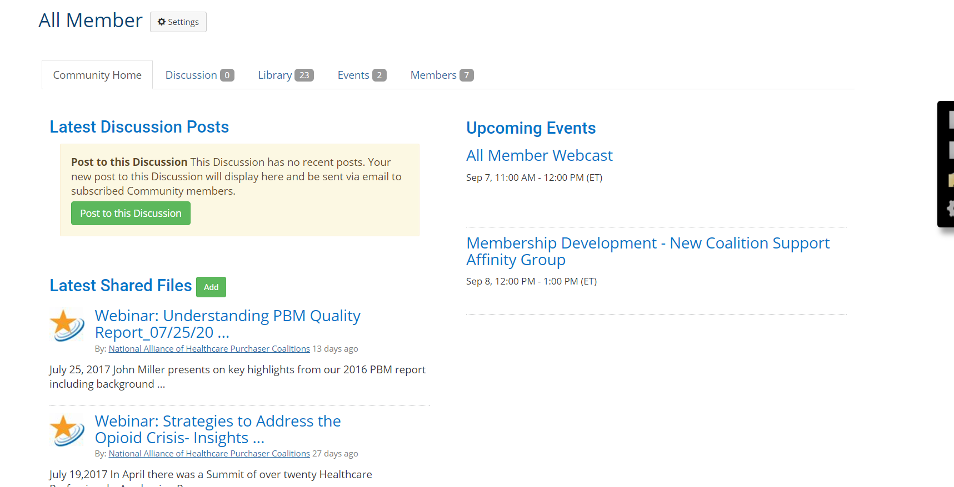
How to Add a Resource to a Community Library
Go to the community’s homepage where you would like to share the file
Find Latest Shared Files, then Add or from Library Tab
Fill out the Title, Description, Folder, and File Type (ex. Webinar, resource, etc.)
Type in your email to identify the owner
Click Next.
Click Choose and Upload File, then upload file.
Click Finish
Add any tags that could go with the Resource

