Slide 1
Fiduciary Check In
Operationalizing Fiduciary Oversight
April 20, 2023

Slide 2
Speakers
Michael Thompson
President & CEO
National Alliance of Healthcare Purchaser Coalitions
Laura Conte
Chief Legal Officer
Advanced Medical Pricing Solutions
Jim Arnold
founder & CEO
finHealth
Tony Sorrentino
President
HPfid Risk Advisors

Slide 3
WHAT DOES IT MEAN TO BE A FIDUCIARY?
ERISA requires fiduciaries to discharge their duties
For the EXCLUSIVE BENEFIT of plan & participants
Using the skills of a prudent person
In accordance with the plan's documents
The threshold for behavior of a healthcare plan fiduciary is a "Good Faith Compliance Effort", which unlike in the retirement plan arena, is much more subjective

Slide 4
Role of Fiduciary
A February 23, 2023 FAQ makes it clear that:
Fiduciary Obligations are no longer just a good idea, they are THE LAW
Plan sponsors need to EDUCATE, ACTIVATE and COMPLETE their fiduciary process by 12-31-23
An activated fiduciary pays LESS for healthcare!!

Slide 5
ERISA “Prudence” – Are you practicing it?
The following duties are derived from a fiduciary relationship:
Duty of Prudence
Duty of Loyalty
Duty to Follow Plan Documents
Fiduciaries have important responsibilities and are subject to standards of conduct because they act on behalf of participants relative to the ERISA Plan and their beneficiaries. The most important responsibilities include:
Acting solely in the interest of plan participants and their beneficiaries
Carrying out their duties prudently
Exclusive purpose of providing benefits to them
Following the Plan Documents* and only pay reasonable plan expenses
The duty to act prudently is one of a fiduciary’s central responsibilities under ERISA. It requires expertise in a variety of areas. Lacking that expertise, a fiduciary will want to engage a third party with professional knowledge to carry out the Plan’s responsibilities and other functions. Prudence focuses on the process for making fiduciary decisions.

Slide 6
Elements of a Fiduciary
Each ERISA Health Plan has certain key elements:
A written plan (i.e. - ERISA Health Benefit Plan), the “Plan Document”, that describes the benefit structure and guides day-to-day operations; an ERISA Fund to hold the plan’s assets
A recordkeeping system to track the flow of money going to and from the ERISA Plan Fund Documents to provide plan information to employees participating in the Plan and to the government.
Employers often hire outside professionals (sometimes called Third-Party Service Providers or Vendors to manage some or all of a Plan’s day-to-day operations. There are usually one or more third-party service providers with discretion over the Plan. These are the plan’s co-fiduciaries
Using discretion in administering and managing a Plan or controlling the Plan’s assets makes that entity a fiduciary to the extent of that discretion or control..
Important to note that a number of decisions are not fiduciary actions but rather are business decisions made by the employer/Plan Sponsor. For example, the decisions to establish a Plan, to determine the benefit package, to include certain features in a Plan, to amend a Plan, and to terminate a Plan are business decisions not governed by ERISA. When making these decisions, an employer is acting on behalf of its business.

Slide 7
Fiduciary Standard
ERISA’s Fiduciary Standard for Prudent Selection Process:
The DOL stated that plan sponsors, administrators, and trustees are covered by ERISA’s fiduciary requirements when selecting a health care plan service provider. As such, the person making the selection must engage in a “prudent selection process”
ERISA requires plan sponsors to pay only “reasonable expenses” for the benefits offered through a health plan. Employers, as ERISA welfare plan fiduciaries, have a duty to verify that the health plan service providers offering services to the plan meet the fiduciary’s quality standards, and that the fees paid to the plan’s service providers and health care providers, are “reasonable”.
DOL further states, It is in the best interest of plan participants that all fiduciaries have the unfettered right to access, analyze, and compare health service providers pricing and quality data.
Some important questions:
How does a fiduciary adhere to this standard?
How to chose the right co-fiduciary with the expertise needed?
Is your co-fiduciary following ERISA standards on your behalf? reasonable services?

Slide 8
finHealth: Top 10 “Troubling Claims” Across Our Clients
Home infusion of Tylenol for $188K (led to credit back to plan for $186K)
Missed provider discount of $131K on a $140K claim (led to credit back to plan for $131K)
Payment of $68K for two breast pumps valued at $400 (led to credit back to plan for $67K)
Payment of $966K for surgeon ($548K) and assistant surgeon ($418K) for Spinal Fusion that was 97 times Medicare for the same surgery (led to plan design change savings ~$500K per month)
Outpatient infusion of the drug infliximab (a.k.a. Remicade) by 5 times the market value resulting in overcharges of $450K over three years (led to go forward price reduction)
Emergency Room visit for “dizziness” paid for $156K (led to plan design change to pay all Emergency Room claims at no more than 250% of Medicare)
One year of dialysis treatments with a fair value of $72K, paid for $798K (led to national Dialysis contract)
Facility charges of $84K for a 60-minute varicose vein surgery on 1 leg (led to credit to plan for $75K)
Missed subrogation claim for $160K where the patient returned to the hospital 5 days after being discharged due to a foreign object left in the body (in process and will result in plan credit for $160K)
Inpatient claim paid at $594K where tragically the patient expired within 12 hours of being admitted through the emergency room (client declined to pursue due to negative publicity)

Slide 9
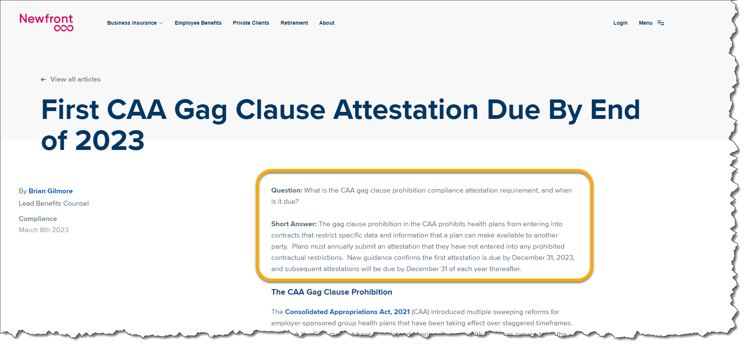
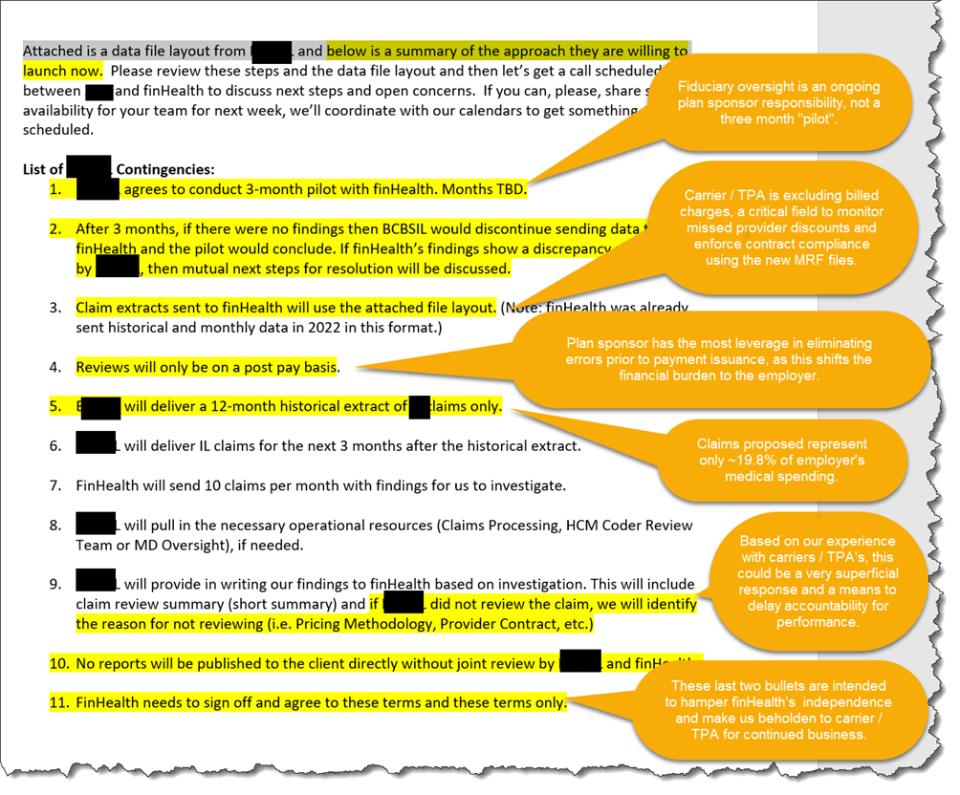
Biggest Challenge Is Obtaining Accurate & Complete Claims Data!
“Data Ransom” Note
(received by finHealth 3/23/23)

Slide 10
“Operationalizing” the Process
Start Process
Review finHealth’s Recommendations and Determine How to Resolve Claim.
Will Claim Be Challenged?
Yes
Client
Set Materiality Level to Pend Claims for Prepayment Review Process (>$50K Tied to Weekly Funding Call).
No
Has Claim Been Resolved?
Request Itemized Bill and Send to finHealth.
Un-Pend Claim and Make Payment.
Work With Client to Resolve Claim and/or Coordinate With finHealth to Contact the Provider.
Payer / TPA
Payer / TPA Soft Denies Claims Over $50K & Sends UB Summary to finHealth.
Yes
No
Was Claim Billed Correctly and at “Fair Market Value” Based Upon the UB Summary?
Summarize Claims Paid That Benchmark Favorably and Forward to Client With Recommendation to Pay.
Evaluate Itemized Bill for Errors and Competitive Rates vs. Industry Cost Benchmarks and the Provider’s Chargemaster. Forward to Client With Recommendation of Value Received.
End Process
No
Contact Provider to Negotiate a Reduction in the Claim Amount.
finHealth
Yes

Slide 11
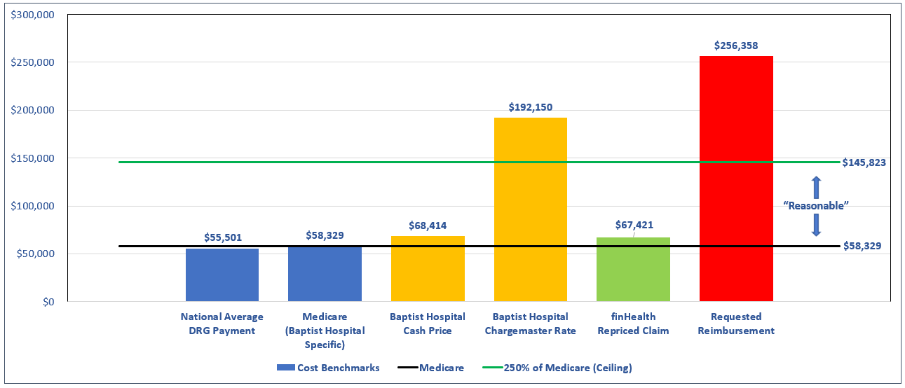
Baptist Hospital - $256,358
DRG Code 453 - Combined Anterior and Posterior Spinal Fusion with MCC
The Average Mean Length of Stay for DRG Code 453 is 9.6 days, and this claim is for a 9 day stay. The provider is requesting reimbursement of $28,484 per day which is 455% of Medicare.

Slide 12
ABC Medical Center
Top 12 Medical Codes Above Market Value = $189K

Slide 13
Speakers
Michael Thompson
President & CEO
National Alliance of Healthcare Purchaser Coalitions
Laura Conte
Chief Legal Officer
Advanced Medical Pricing Solutions
Jim Arnold
founder & CEO
finHealth
Tony Sorrentino
President
HPfid Risk Advisors

Slide 14
Upcoming Webinars and Events
Accelerating Health Equity Using Workplace Policies & Benefits
May 23, 2023, 12 p.m.-1:30 p.m. ET
2023 Leadership Summits
June 28 -29, CT

