Slide 1
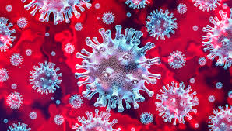
Employer Town Hall COVID-19 Response Post Mandate December 7, 2021 4:00 PM ET

Slide 2
Moderator & Participating Panel
Today’s Panel
Ray Fabius, MD, Co-founder, HealthNEXT
Jenny Goins, President & CEO, Kentuckiana Health Collaborative
Andrew Kobylinski, CEO, Primary Health
Wayne Rawlins, MD, VP and Chief Medical Officer, WellSpark
Ashley Reynolds, Chief Experience Officer, BioIQ
Cristie Travis, CEO, Memphis Business Group on Health
Noah Wayne, PhD, Vice President, Clinical Programs, NexJHealth
Michael Thompson
President & CEO
National Alliance
Mark Cunningham-Hill, MD
National Alliance Medical Director Advisory Council
Northeast Business Group on Health
Medical Director

Slide 3
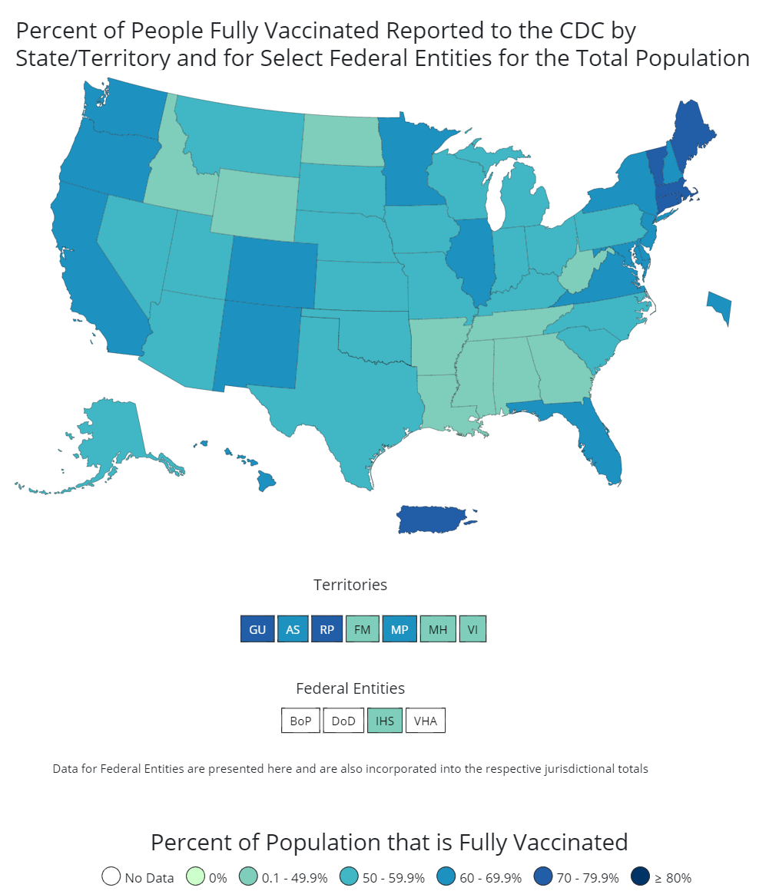
Current Issues & Activities
199.3M People are fully vaccinated
71.5%
>18+
are fully vaccinated
Current State
Federal Government “Mandate”
OSHA ETS
Vaccination rates rising
All 3 vaccines approved for booster
New COVID therapies (e.g. Merck, Pfizer)
NYC Mandate
Today’s Discussion
Relative benefits of PCR, rapid molecular, rapid antigen testing
Implementation of OSHA standards - vaccination vs. testing
Preparing for potential workplace outbreaks
Considerations related to natural immunity
Implications of Omicron variant
63.8% of those eligible
are fully vaccinated
47.0M
People received a booster dose**
**The count of people who received a booster dose includes anyone who is fully vaccinated and has received another dose of COVID-19 vaccine since August 13, 2021. This includes people who received booster doses and people who received additional doses
Source: https://covid.cdc.gov/covid-data-tracker/#vaccinations_vacc-people-fully-percent-total

Slide 4
OSHA Emergency Temporary Standards (ETS) Recommendations COVID -19 Testing in an Employer Population
PCR
Most expensive
Can be done at home, onsite or at a community testing center and sent to the lab for analysis
Can take 24-48 hours to get the result
Person who is positive may be in the workplace for a day or two before they get their result - Could increase risk of spread to others
Very sensitive and can remain positive for weeks after an infection even though the person is no longer infectious
Rapid Molecular
(e.g., Lucira, Abbott ID Now, Color Health)
Moderately expensive
Need health technician to manage tests
Quick result - 1 hour
Have been accuracy issues but newer test better
Rapid Antigen
(not antibody testing)
Cheapest
Self-administered and done at home, the workplace and at a community testing center
Quick – results in 15-20 minutes
Good at picking up those who are infectious but not those in pre-infectious period
The most flexible and cost-effective testing platform for this would be rapid antigen testing

Slide 5
Implementation of OSHA ETS Vaccination vs. Testing
Vaccination mandate vs testing alternative
Frequency of testing
Testing can be paid for by the employer or employee, unless state regulations say otherwise
Process for managing positive results
Sending employee home and isolating them
If test positive from a rapid antigen test, then option to do a confirmatory PCR test and if this is negative the person can return to the workplace
It is also possible to accept all rapid antigen tests as true positives as the false positive rate in practice tends to be less than 1%
Vaccination and Testing are not equivalent safeguards

Slide 6
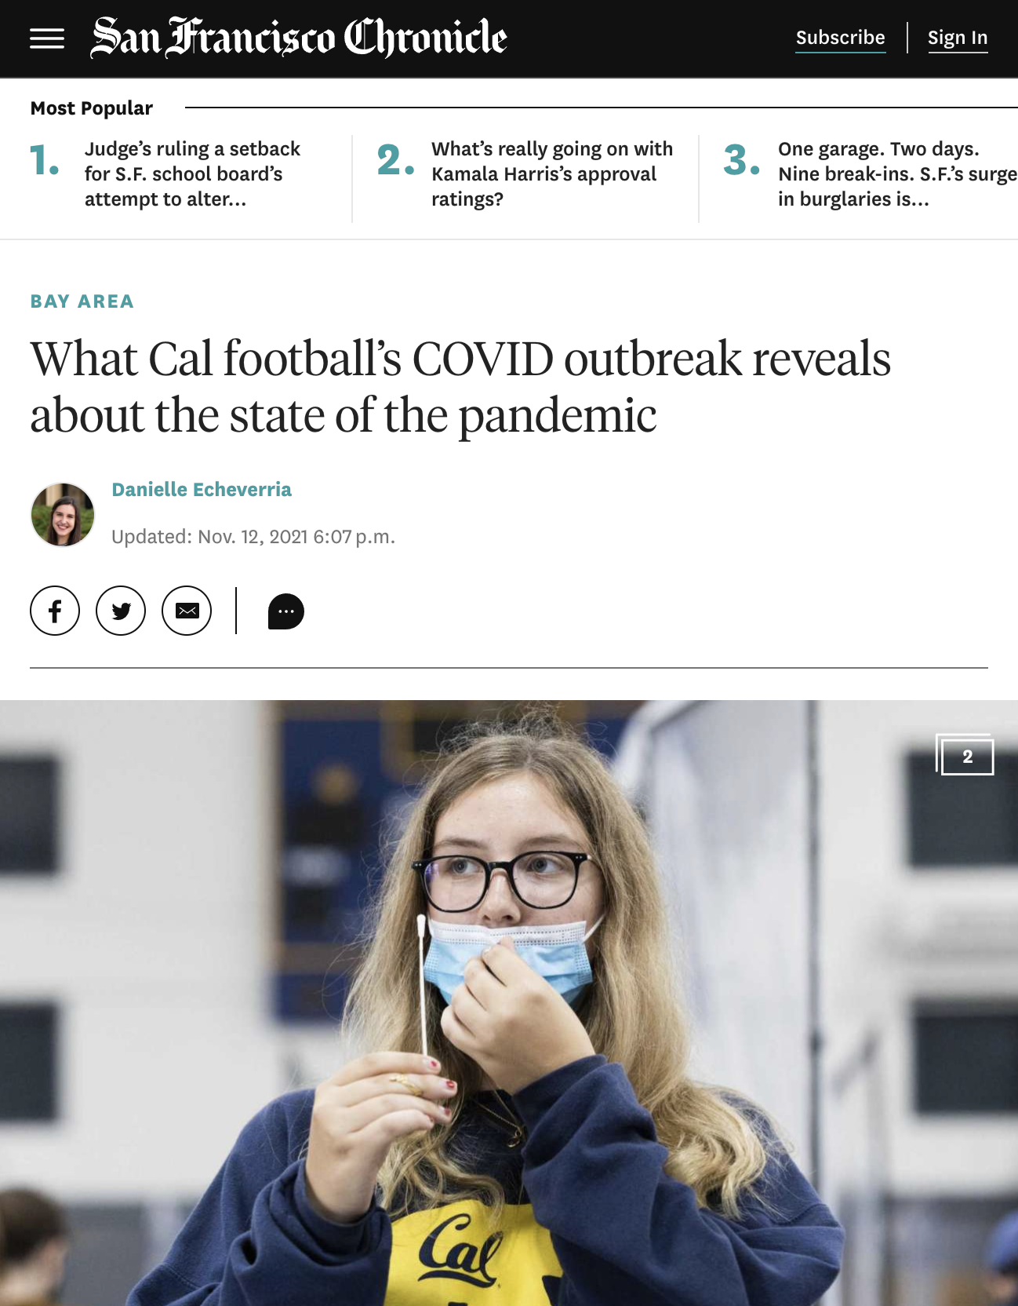
Preparing for Potential Workplace Outbreaks
Delta Surge
Hitting vaccinated population
Spreading in schools/workplace
Booster uptake is too low
Testing is too limited and many infections go undetected
Outbreaks amongst vaccinated
Not well understood
May need to trigger mandatory testing
Contingency planning required now
UC Berkeley’s recent case:
“...university officials revealed that of 172 team players, staff and volunteers tested, 46 were infected — and at least 31 were symptomatic.”

Slide 7
Consideration Related to Natural Immunity
Natural immunity
Acquired from exposure to the disease organism through infection with the actual disease
Once exposed, immune system will recognize it and immediately produce the antibodies needed to fight it.
Many governments accept evidence of a past COVID infection within 90 days for exemption from vaccine requirements and travel
COVID-19 and Natural Immunity
Recent Israeli study found that natural immunity is much more effective than vaccines in protecting individuals
CDC perspective
Getting vaccinated for the coronavirus when you’ve already had COVID-19 significantly enhances your immune protection and further reduces your risk of reinfection
If you had COVID-19 before and are not vaccinated, your risk of getting re-infected is more than two times higher than for those who got vaccinated after having COVID-19
Roughly one-third of those with COVID-19 cases in the study had no apparent natural immunity
Some studies show that natural immunity to the coronavirus weakens (wanes) over time and does so faster than immunity provided by COVID-19 vaccination.
Omicron – evidence that the omicron variant reinfects people who have had COVID at a higher rate than delta

Slide 8
The Omicron Variant
Already spread to 50 countries and local transmission in several countries
Evidence that it is more infectious
Evidence that it can evade past infection with COVID
Encouraging early evidence that it may cause milder disease BUT too early to be certain
Impact on vaccines is not yet known – experts optimistic that vaccines will still protect against severe disease
Breakthrough infections do occur – unknown if at a similar or higher rate than with delta
May have implications for future vaccines

Slide 9
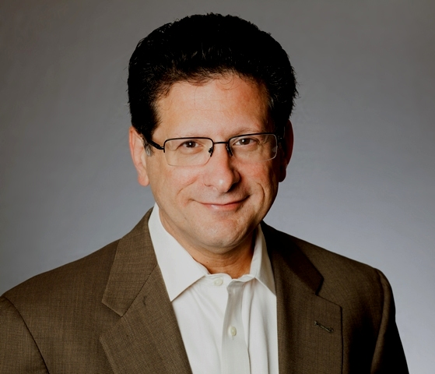
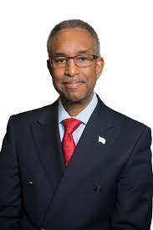
Questions?
Ray Fabius, MD
Co-founder
HealthNEXT
Jenny Goins
President & CEO
Kentuckiana Health Collaborative
Andrew Kobylinski
CEO
Primary Health
Wayne Rawlins, MD
VP & Chief Medical Officer WellSpark
Ashley Reynolds
Chief Experience Officer
BioIQ
Cristie Travis
CEO
Memphis Business Group on Health
Noah Wayne, PhD
Vice President, Clinical Programs
NexJ Health

Slide 10
Summary – How to Keep Workplaces Safe
Try and ensure everyone in the workplace is vaccinated and has a booster when eligible
Based on community risk:
Require mask wearing for all or at least high-risk activities
Implement an effective testing program
Minimize number of people in the workplace
Physical distancing
Optimize ventilation
Educate employees – COVID, Vaccines, Medicines, how to stay safe, testing positive, symptoms, etc…
Communicate, Communicate, Communicate!
Watch the science and adapt as needed
“By Failing to prepare, you are preparing to fail.”
– Benjamin Franklin

Slide 11
Upcoming Webinars
December
Rethinking how Employers Support the Obesity Patient Journey
December 9, 2021, 3-4 pm
December 14: Compliance Alert: 4 Things Employers Must do by January 1 -- Your New CAA Transparency Fiduciary Responsibilities Explained
December 14, 2021, 11-12 pm
All times are Eastern Time

