Slide 1
Employer Town Hall:
Accelerating Health Equity Using
Workplace Policies & Benefits
May 23, 2023

Slide 2
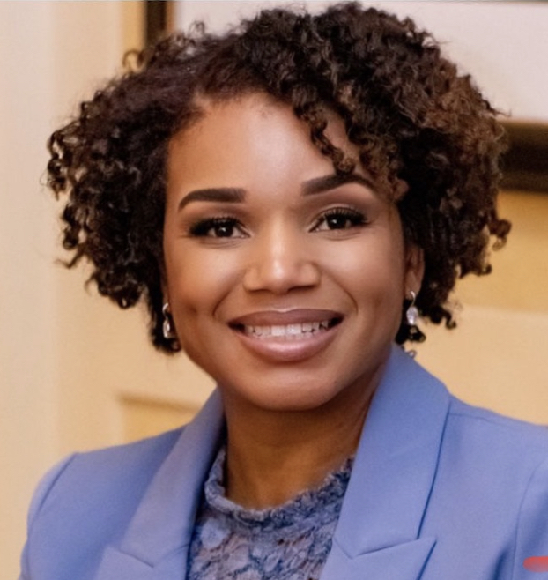
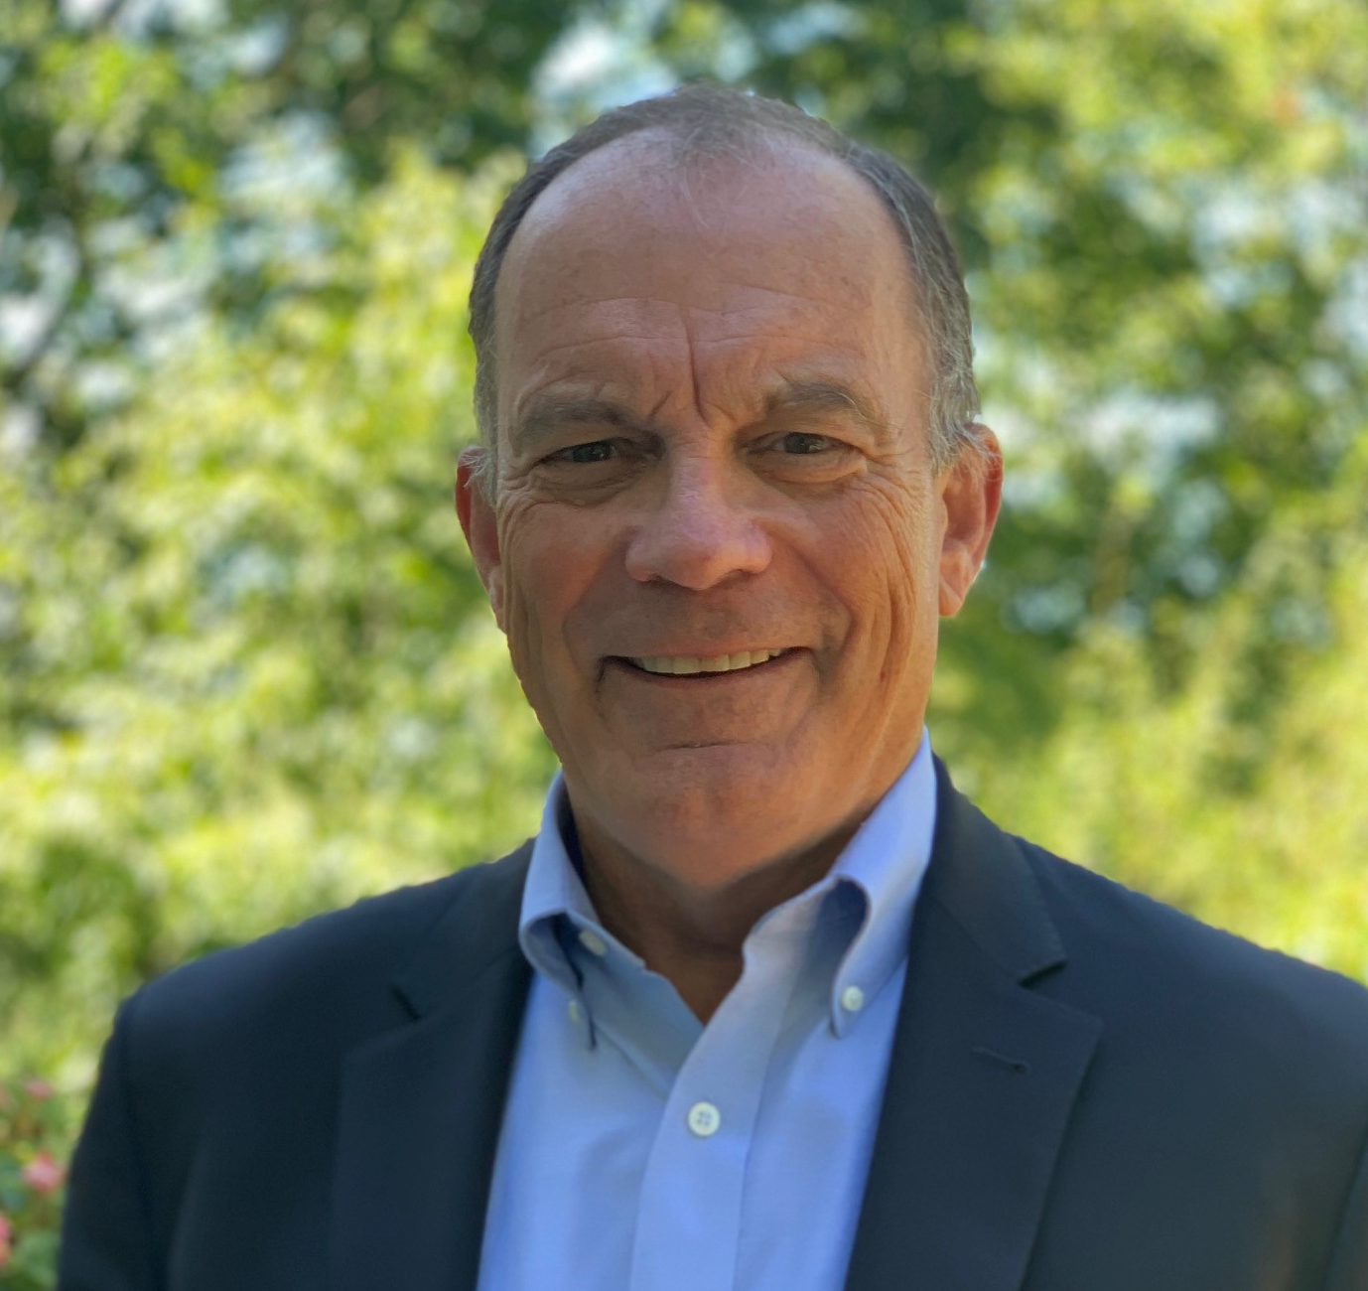
Moderators & Panel
Panelists
Tammy Fennessy, American Eagle
Rosa Novo, Miami Dade County Public Schools
Wayne Rawlins MD, Wellspark
Christa-Marie Singleton MD, CDC/Office of Personnel Management
Dexter Shurney MD, Blue Zones Well-Being Institute
Cristie Travis, HealthcareTN
Christina Bell
Moderator
Michael Thompson
Moderator

Slide 3
Health Equity:
The Building Blocks
Sustain Culture of Inclusion
Makeup of governance & key advisors
Inclusion in balanced scorecard
Organization values & objectives
Investment consistent with needs & strategy
Evaluate & Engage
Supply Chain
Include equity & inclusion in accountabilities
Focus on direct (health plans, vendors) and indirect (providers) influence
Create transparency on performance
Align incentives with expectations
Integrate Equity into Strategy
Break down silos (e.g., D&I, HR, benefits, wellbeing)
Establish equity metrics for programs
Improve program responsiveness
Extend cultural focus (e.g., culture of health, safety & equity)
Understand Impact of Differences
Engage diverse communities
Obtain data at community and organizational level
Analyze “variation” not “averages”
Examine business case to address

Slide 4
Health Equity:
The Building Blocks
Sustain Culture of Inclusion
Makeup of governance & key advisors
Inclusion in balanced scorecard
Organization values & objectives
Investment consistent with needs & strategy
Evaluate & Engage
Supply Chain
Include equity & inclusion in accountabilities
Focus on direct (health plans, vendors) and indirect (providers) influence
Create transparency on performance
Align incentives with expectations
Integrate Equity into Strategy
Break down silos (e.g., D&I, HR, benefits, wellbeing)
Establish equity metrics for programs
Improve program responsiveness
Extend cultural focus (e.g., culture of health, safety & equity)
Understand Impact of Differences
Engage diverse communities
Obtain data at community and organizational level
Analyze “variation” not “averages”
Examine business case to address

Slide 5
Equality vs. Equity
Execs vs. Other Salary vs. Hourly
Race & Ethnicity
Other
Income
Job Function
Health Literacy
Technology

Slide 6
Refocusing on Low Income & Vulnerable Populations
Cost Sharing
Income based benefits
Telehealth
High Tech and High Touch Navigation
Flexibility

Slide 7
Case Study: Equity in Mental Health
Lenses Affecting Health Equity
Income
Race
Culture
LGBTQ+
Education
Language
Environmental Factors
Unique demands & stressors
Social determinants
Workplace
Stigma
Racism/Bias
Neighborhood/Community
Implications for Mental Health Strategy
Engagement of ERGs/BRGs
Cultural competence/shared experience
Access
Affordability
Trust
Environmental Support

Slide 8
Benefits & Policies Impacting Health Equity
Medical Benefits (cost sharing, networks, navigation, communications, etc.)
Health Support Programs (wellbeing, maternity, cancer, etc.)
Paid Time Off
Short Term Disability
Caregivers
Bereavement
Retirement

Slide 9
Addressing Potential Pushback
Discrimination/Favoritism
Targeting specific subpopulations
No Data
Wokeness/Cultural Divide
Business Case

Slide 10
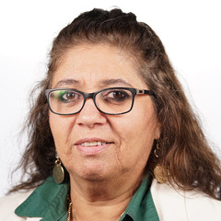
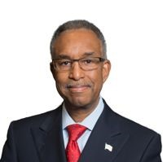
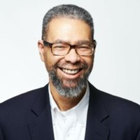
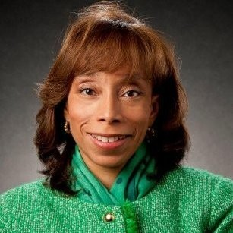
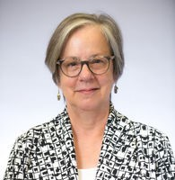
Open Discussion
Tammy Fennessy
American Eagle
Rosa Novo
Miami Dade County Public Schools
Wayne Rawlins, MD
Wellspark
Dexter Shurney, MD
Blue Zones Well-Being Institute
Christa-Marie Singleton, MD
Office of Personnel Management
Cristie Travis
HealthcareTN

Slide 11
2023 Leadership Summits
June 28 – 29 | Nashville, Tennessee
Gaylord Opryland Resort & Convention Center
Surviving to Thriving
Creating the Distinctive Approach to Wellbeing
Women’s Health: Navigating the Life’s Cycle
Breaking Barriers to Meet People Where They Are
RACE to be Human
Architecting for Value
Cutting Costs and Not Culture
Innovation & Integration
Addressing the Universe of One
FIRESIDE CHAT: Elevating Engagement Across the Spectrum
The Paradox of Serving Everyone: The Equity Challenge

